Slide 1



amazon ecommerce sales
View in Power BI
Last data refresh:
3/16/2026 11:31:41 AM UTC
Downloaded at:
3/16/2026 1:29:48 PM UTC

Slide 2
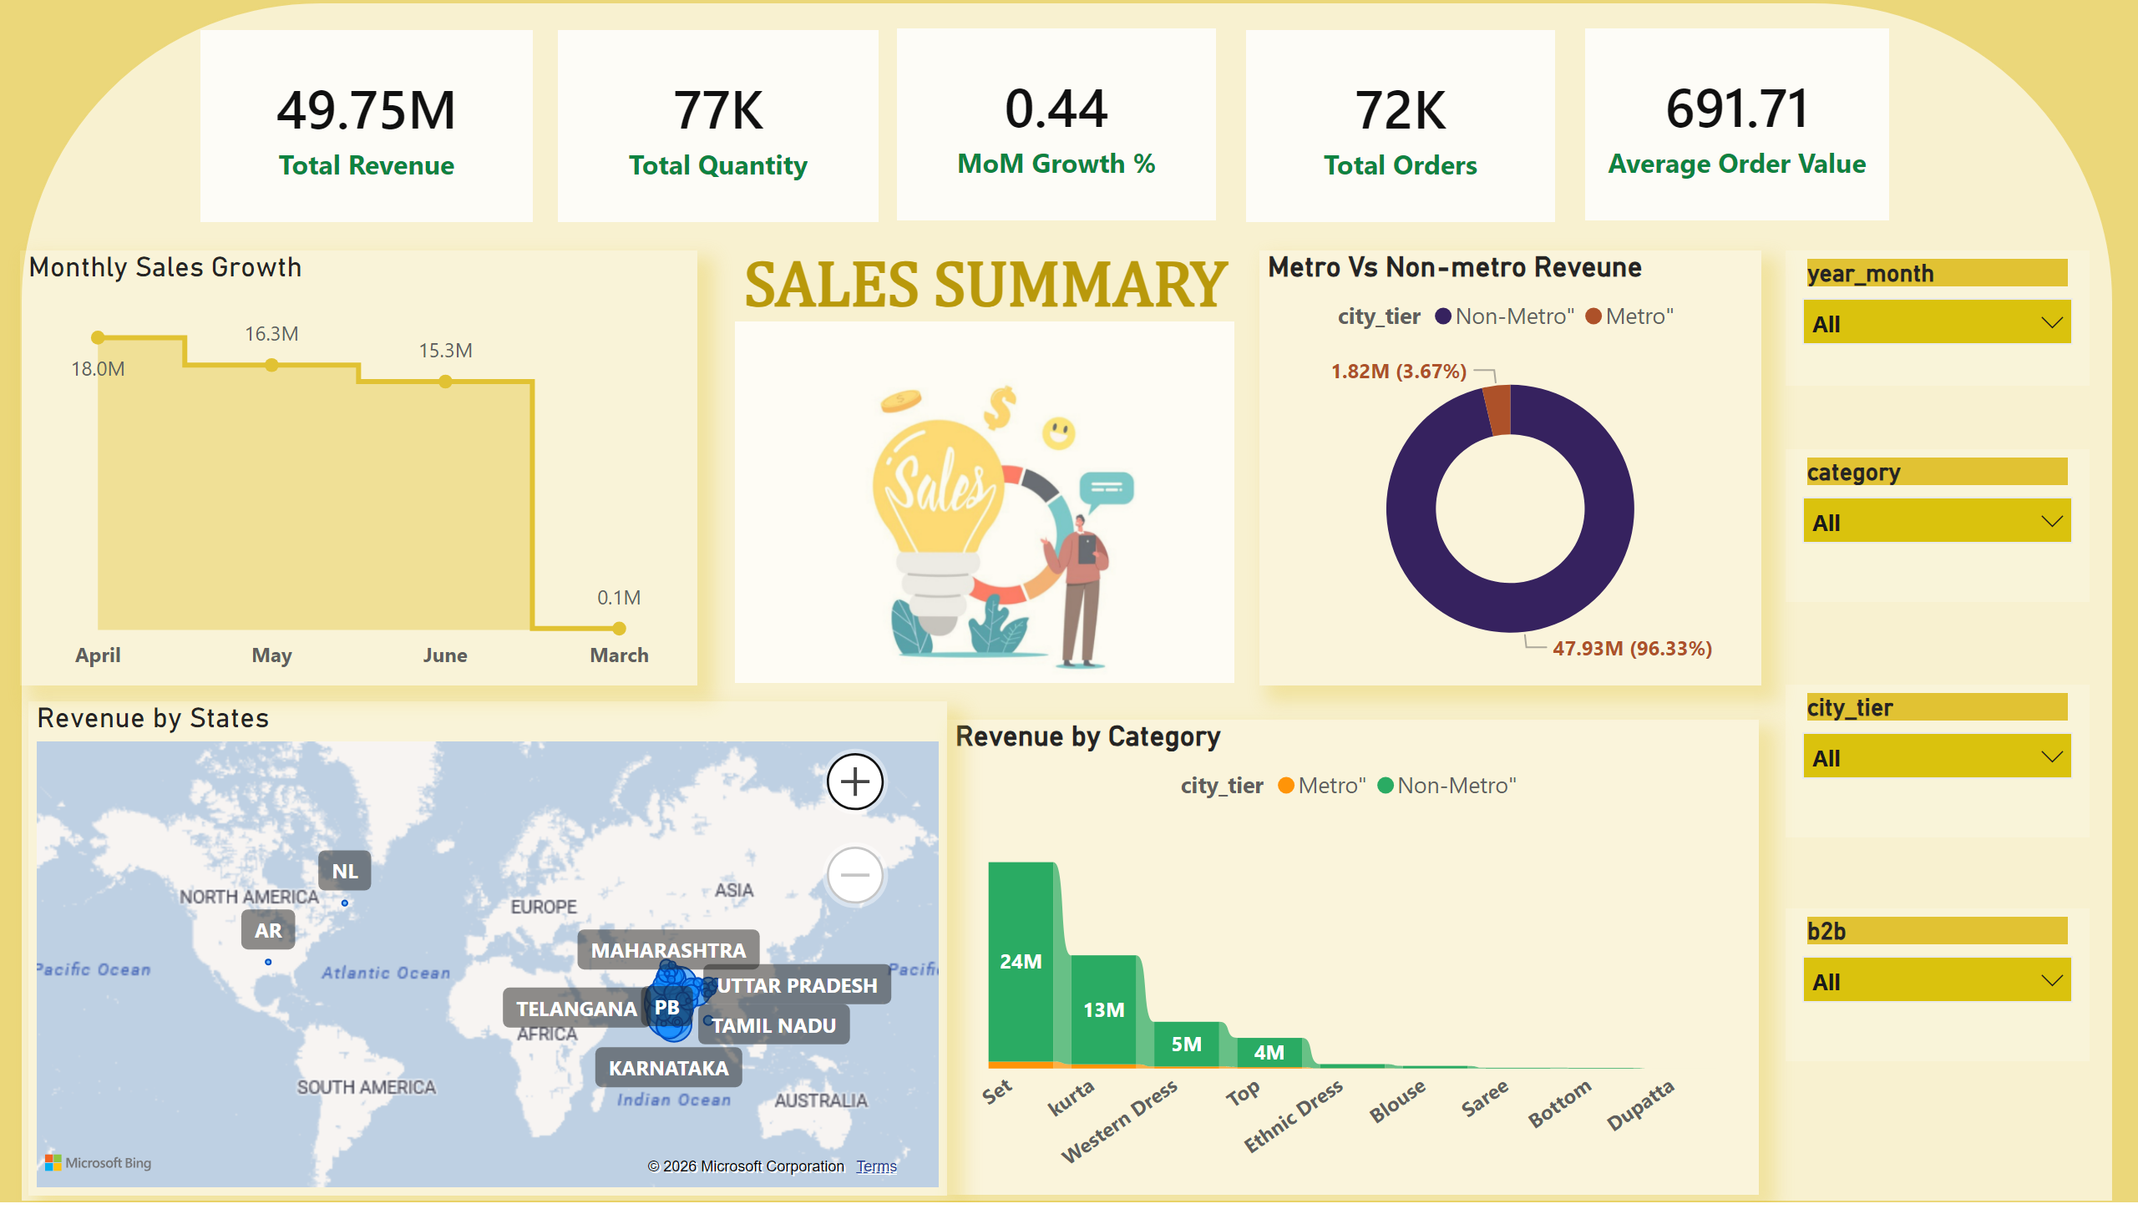
Sales summary
Notes:
shape
No alt text provided
image
No alt text provided
SALES SUMMARY
No alt text provided
Monthly Sales Growth
No alt text provided
cardVisual
No alt text provided
cardVisual
No alt text provided
cardVisual
No alt text provided
cardVisual
No alt text provided
cardVisual
No alt text provided
Revenue by Category
No alt text provided
Revenue by States
No alt text provided
Metro Vs Non-metro Reveune
No alt text provided
slicer
No alt text provided
slicer
No alt text provided
slicer
No alt text provided
slicer
No alt text provided

Slide 3
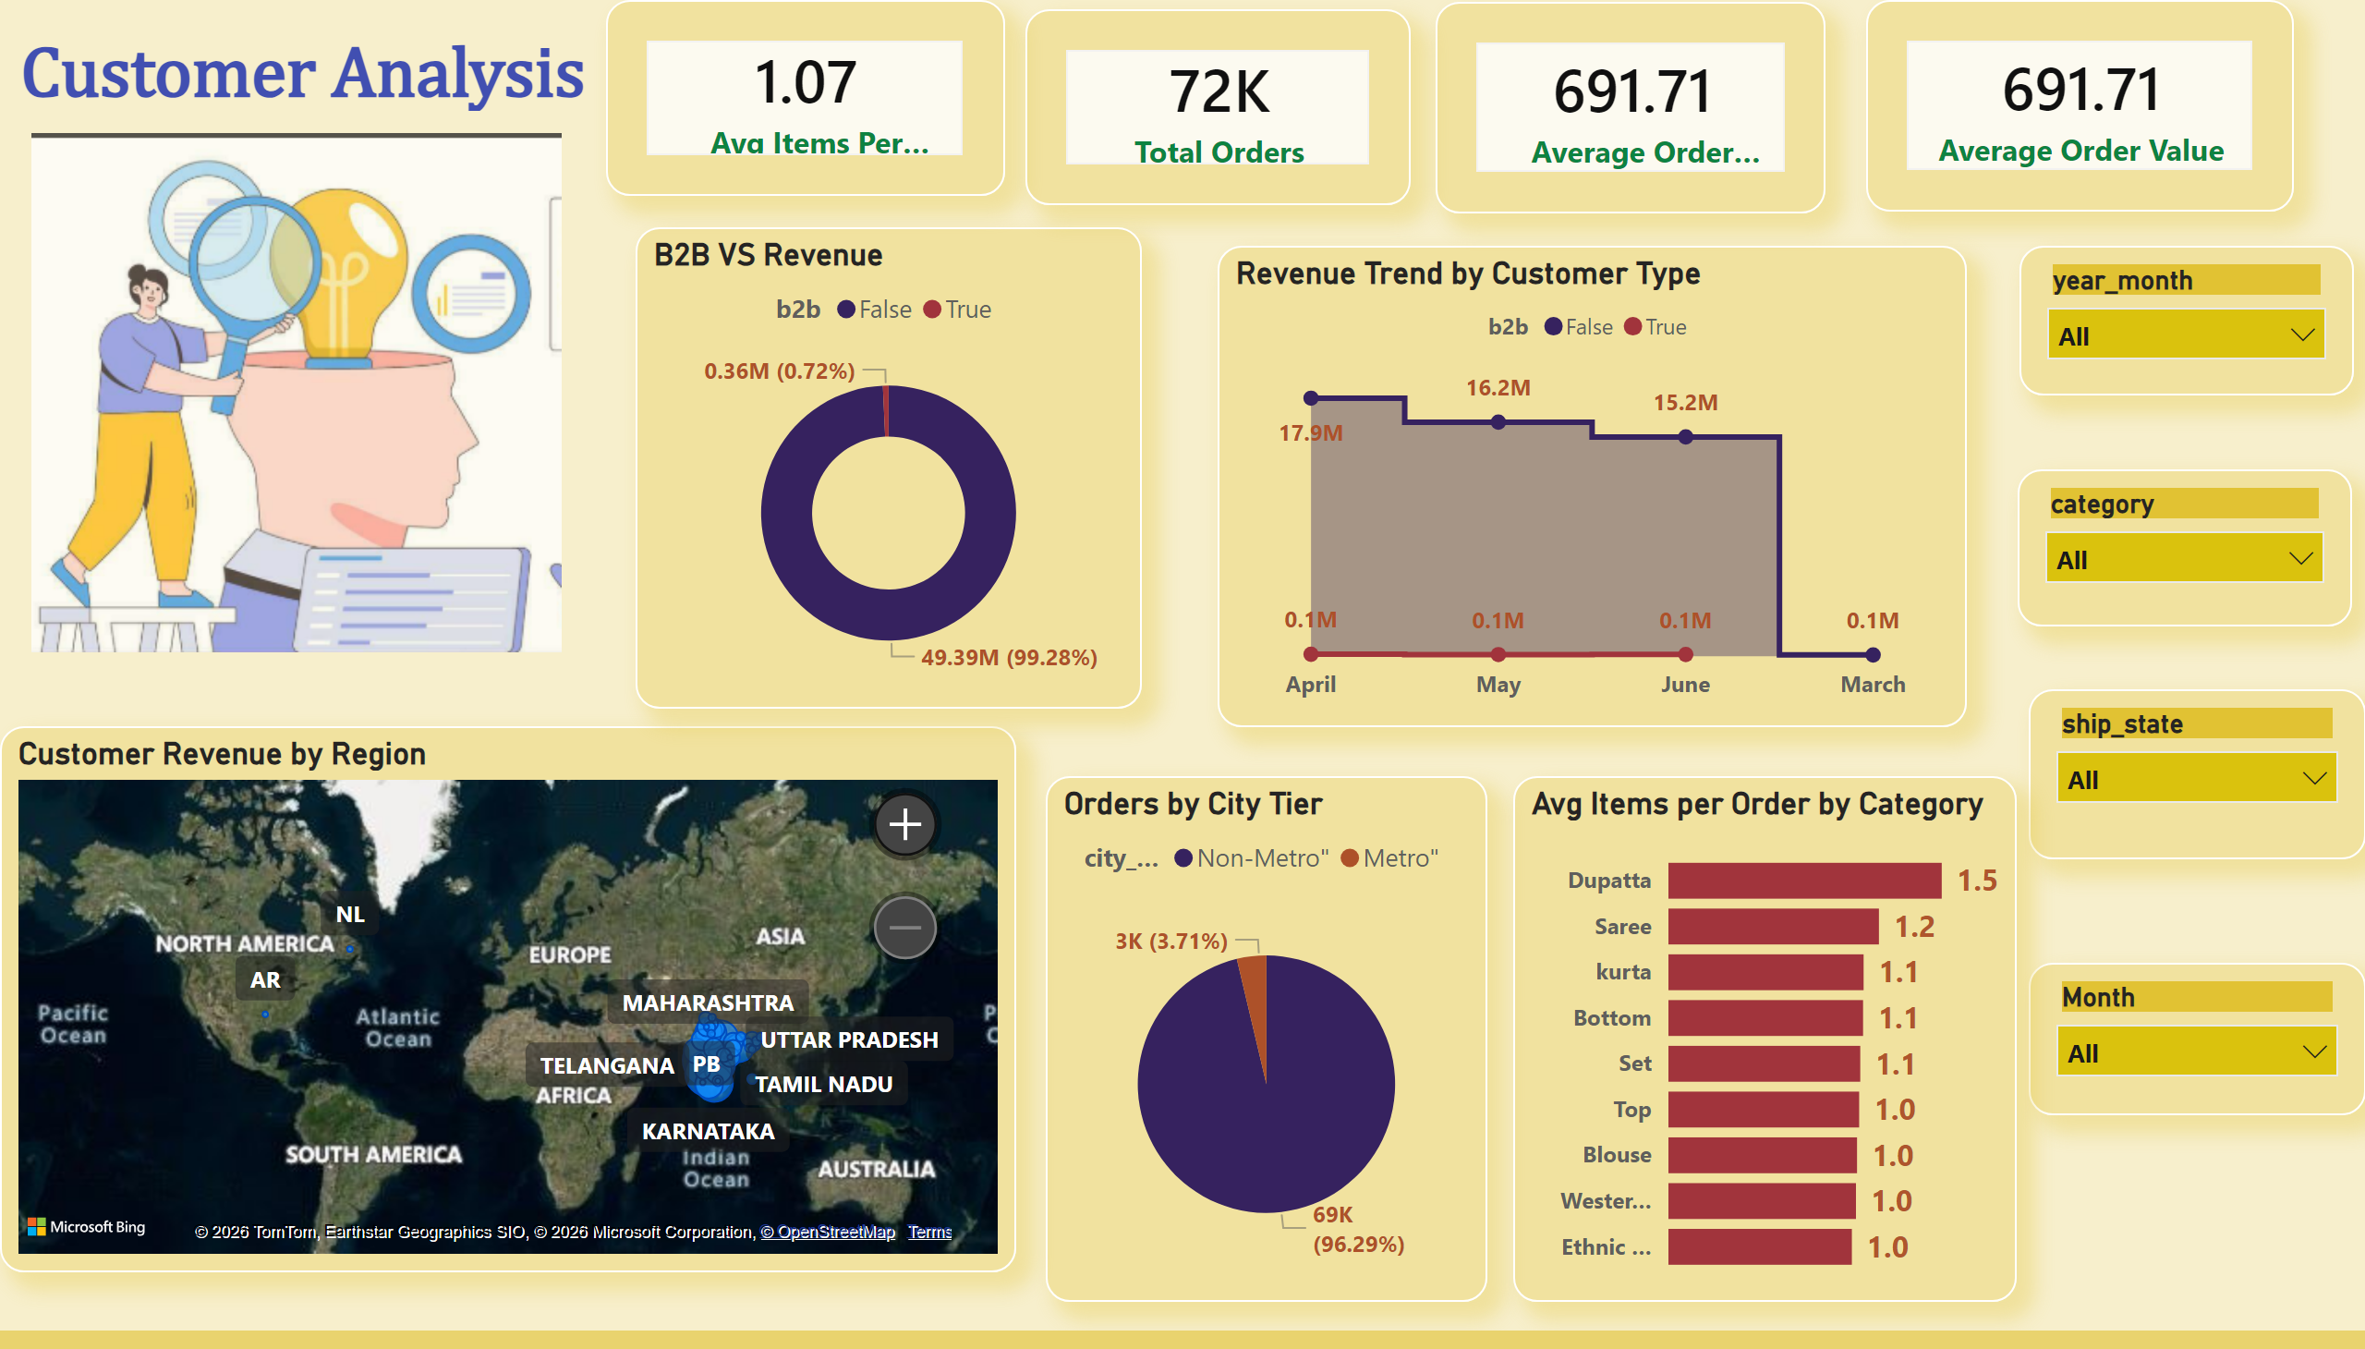
Customer Analysis
Notes:
image
No alt text provided
Customer Analysis
No alt text provided
Revenue Trend by Customer Type
No alt text provided
cardVisual
No alt text provided
cardVisual
No alt text provided
cardVisual
No alt text provided
cardVisual
No alt text provided
Orders by City Tier
No alt text provided
Customer Revenue by Region
No alt text provided
B2B VS Revenue
No alt text provided
slicer
No alt text provided
slicer
No alt text provided
slicer
No alt text provided
slicer
No alt text provided
Avg Items per Order by Category
No alt text provided

Slide 4
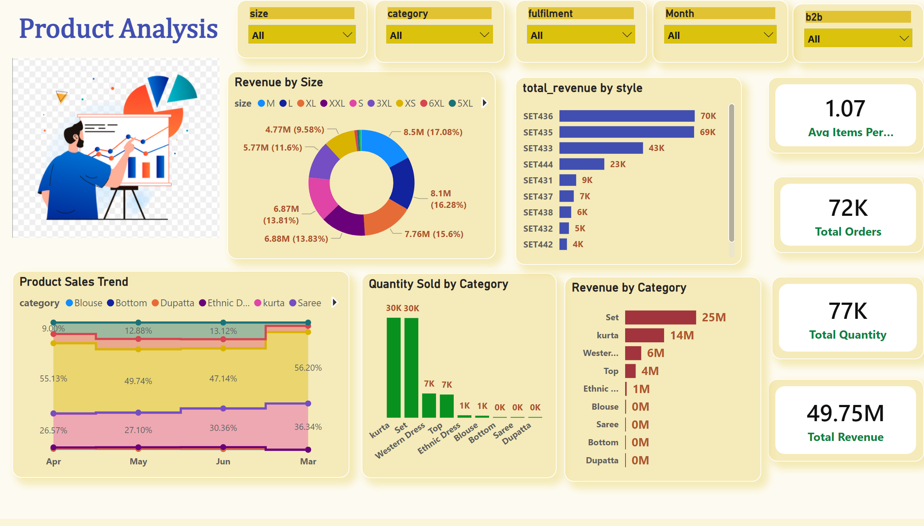
Product Analysis
Notes:
image
No alt text provided
Product Analysis
No alt text provided
Product Sales Trend
No alt text provided
cardVisual
No alt text provided
cardVisual
No alt text provided
cardVisual
No alt text provided
cardVisual
No alt text provided
Quantity Sold by Category
No alt text provided
Revenue by Size
No alt text provided
slicer
No alt text provided
slicer
No alt text provided
slicer
No alt text provided
slicer
No alt text provided
Revenue by Category
No alt text provided
slicer
No alt text provided
clusteredBarChart
No alt text provided

